Slide 1
15-112 Term Project Xilliard
Shaoxuan Yuan(Max)

Slide 2
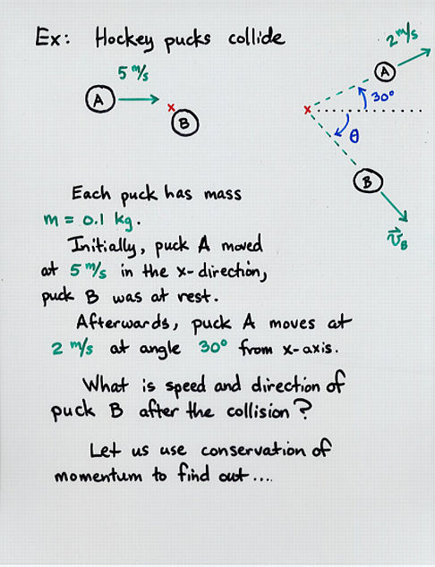
Trigonometric vector calculation system:

Slide 3
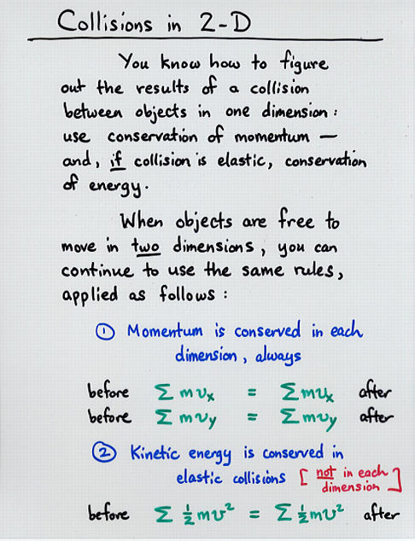
Momentum Conservation

Slide 4
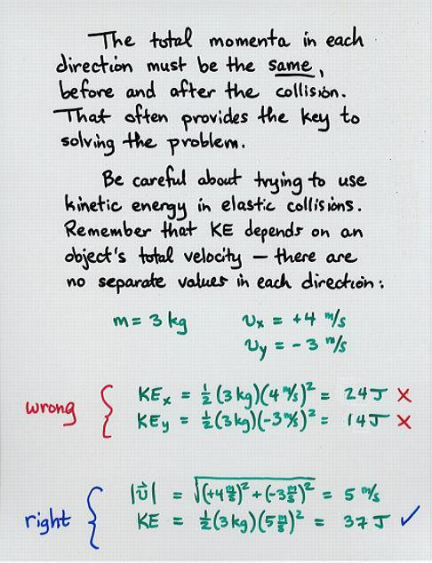
Kinetic Energy Conservation

